Slide 1
Working With Assembly
Lessons from the Motorola 68000 assembly language by Josh Desmond

Slide 2
Project Itinerary:
Learn the language
Design an algorithm/Plan a project
Write the code

Slide 3
Learning the Language
Dissect code
Write code
Read the manual

Slide 4
Planning a Program
Write a flowchart
Code the program
Expand the program

Slide 5
How does it work?
Communication to windows for mouse input and graphics are handled externally
The physics loop deals only with velocity vectors and positions (with collision detection exceptions)
The graphics algorithm works by using length to build a square for each ball, then using an EASy68K directive to draw.

Slide 6
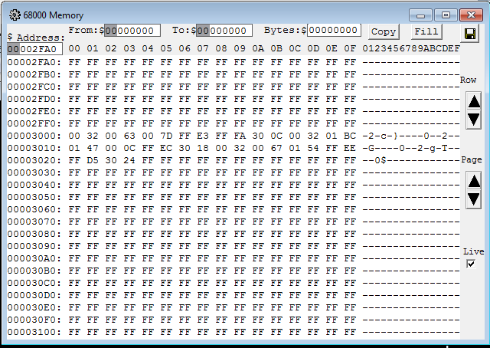
How does it work?: Memory

Slide 7
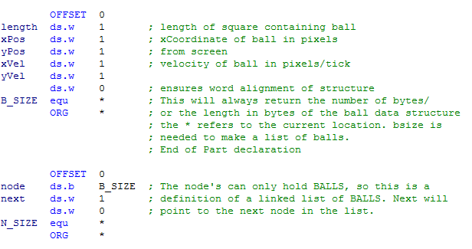
Ball Definition:

Slide 8
Ball Definition:
length: 0
xPos: 2
yPos: 4
xVel: 6
yVel: 8
B_SIZE: 10
node: 10
next: 12

Slide 9
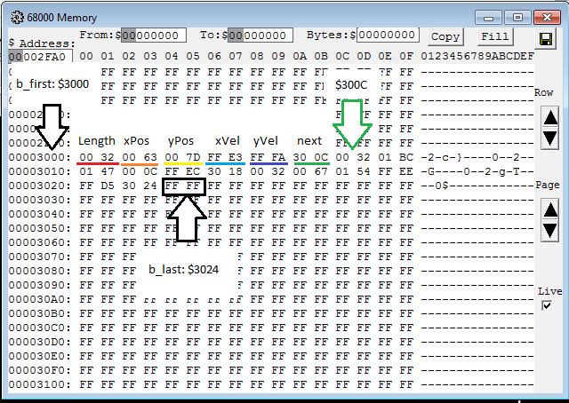
How does it work?: Memory

Slide 10
Commentary + Questions?

Slide 11
The end- Thanks!

